Slide 1
ALTERNATIVE DATA COLLECTION IF FIELD VISITS ARE NOT POSSIBLE IN TIMES OF COVID-19
YAM NATH GIRI,
INDEPENDENT DEVELOPMENT PROFESSIONAL| M & E| Research| Livelihood| Education| Planning| Governance| SDG |
Notes:
Toma you have to rearrange slides as per hierarchy. you can delete or add slides.

Slide 2
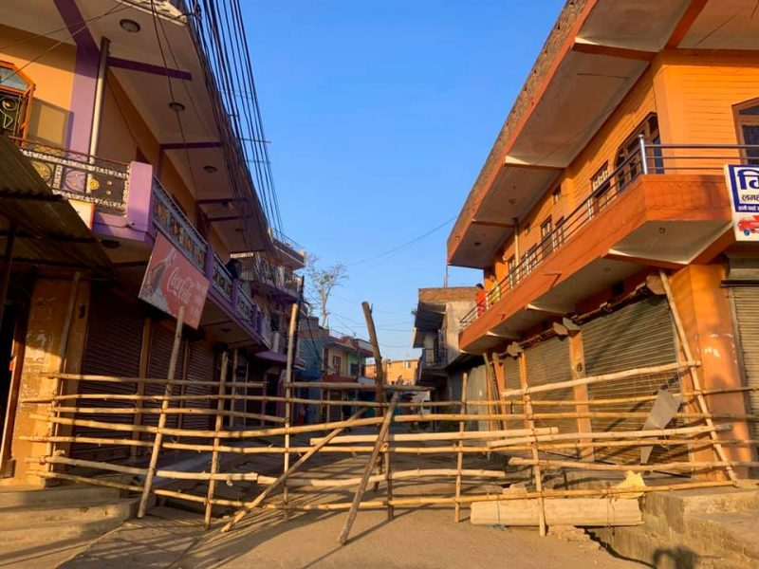
Challenges
Only modern technologies may not be effective in every aspect "off-site” evaluations

Slide 3
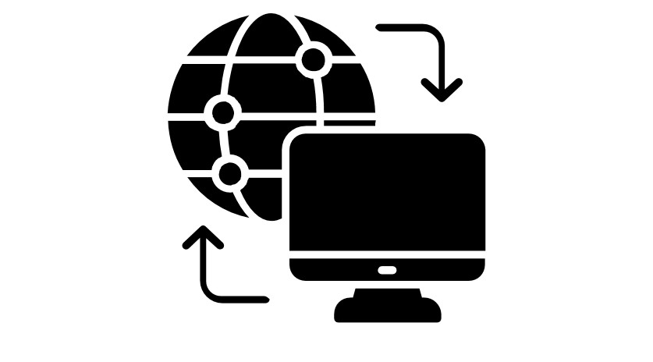
Context
Beneficiaries age
*Youth
*Middle age
*60+
Internet connection
*Available
*Not available
Phone connection
*Available
*Not available
On-site visits for locals:
*Possible
*Not possible
Project phase:
*Pre-start
*Mid-term
*End
Emergency situation
*Yes
*No

Slide 4
Theory of Change
Use of modern technology and innovative ideas in data collection bring accurate, credible and reliable evaluation without physical presence of evaluators

Slide 5
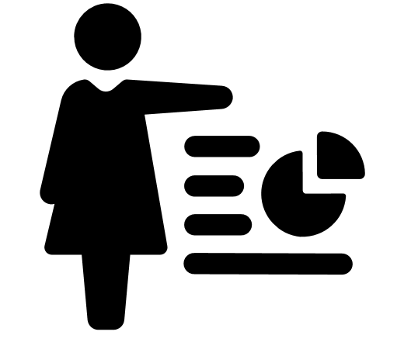
Possible Tools For Off-Site Evaluation
Participatory Statistics
Uses of local resources
Case Studies
Stories from Newspaper
Journal Articles
Online Surveys
Micro Narratives
Phone surveys (Voice Menu, SMS)
Notes:
Beneficiaries generate
statistics themselves (participatory statistics)

Slide 6
Stakeholders and Resources
Resources: Evaluators, Beneficiaries, Project staffs, Internet, Telephone, Project Documents, Newspaper etc.
Stakeholders: Evaluators, Beneficiaries, Project Staffs, Government Line Agencies
Notes:
Stakeholders: Who is involved and what is their need and stake?
resources that we used

Slide 7
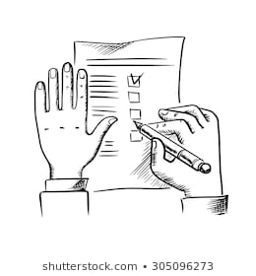
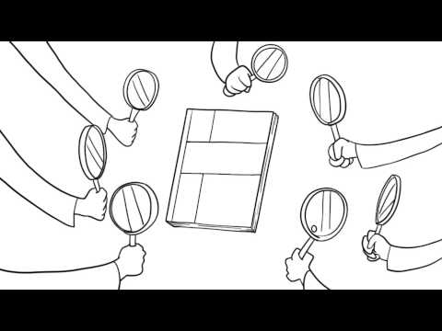
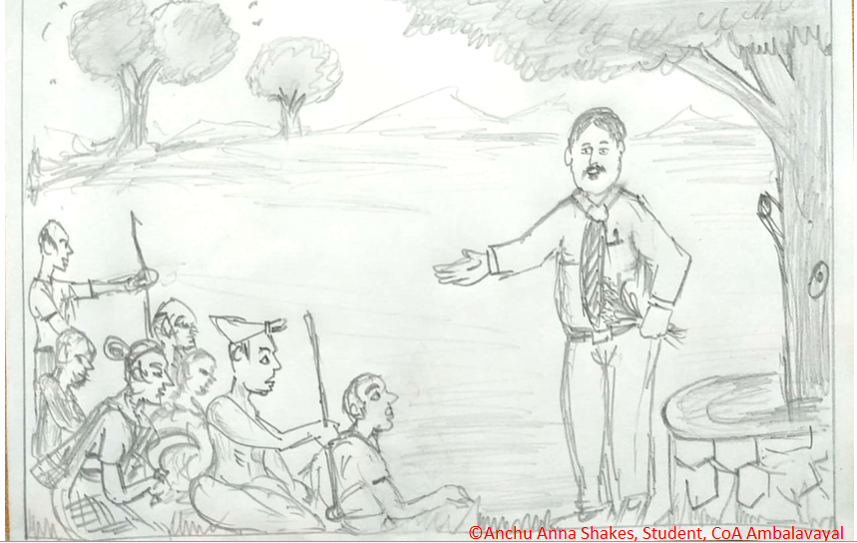
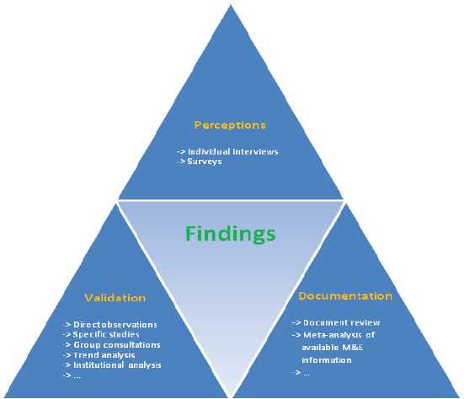
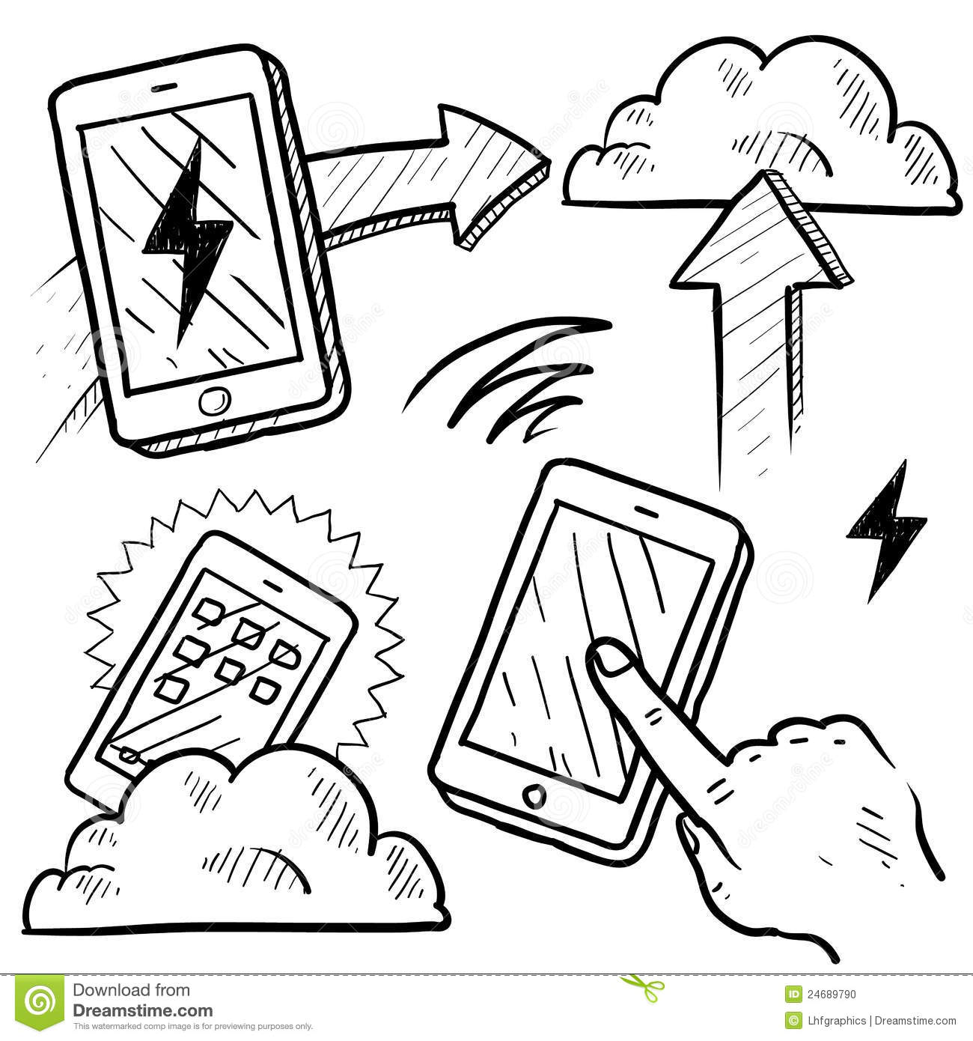
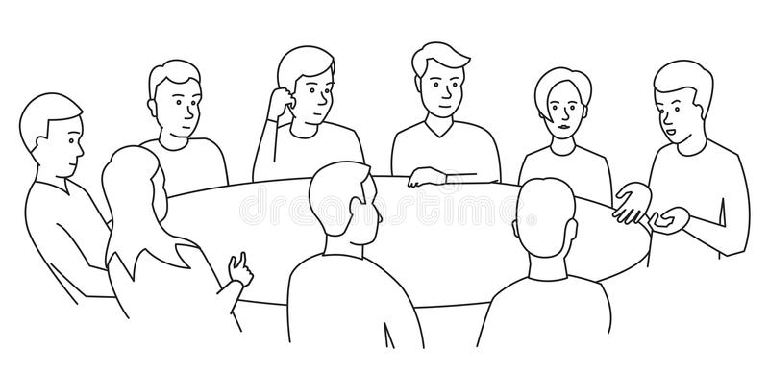
PS How it Works?
If project/programme already capacitated them
Identifies an evaluation or study approach/design to be undertaken
Developed checklist/questionnaire
Find out capacity of beneficiaries
Triangulated this with micro-narrative, case studies which were previously developed, journal articles, project documents, news articles
Circulate checklists/questionnaire
Beneficiaries sit together and fill up checklist
When confident on credibility of data move to prepare report
Send to evaluators

Slide 8
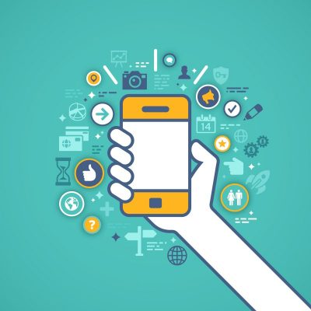
PS How it Works?
If Not Possible Move into, alternative way of data collection
Develop study/evaluation approach/design
Hire a professional local enumerator/ facilitators
Develop digital offline data collection tools
Develop training module/resource and materials
Conduct training offline/online/indirect
Tested by the evaluator, either through the platform or via phone/video conference
Data collection

Slide 9
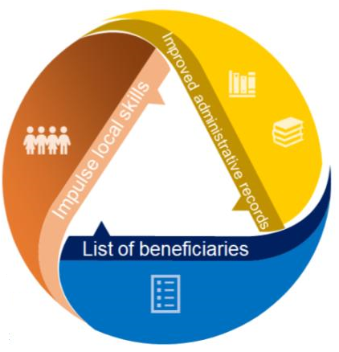
Model
Improved Administrative Records
Systematize administrative records
Use information already being collected and could assess who is reachable and who is not
Administrative record including initial assessment of resiliency
Elements to include administrative records: Social cohesion, support networks, access to different technologies.
Impulse Local Skill
Training of a group of data collectors (Under normal circumstances) and during extraordinary time special training can be done remotely
Sustainable capacity building useful in the long term
Trust of people to provide information to locals
Also building up local capacities to collect participatory statistics
Coordinated List of Beneficiaries
Coordination among ministries
Social programs could target people with similar characteristics, with different interventions. Useful to construct contrafactual groups
Integrated with administrative data

Slide 10
Assumption and Limitations
Assumptions
That local community members are available and willing to be trained as facilitators
That evaluators will be willing to trust their data collection to novice data collection facilitators
Limitations
Would still face limitations based on digital connectivity barriers
Appreciation: The contribution Gabriela Rentería, and Toma Kabysh-Rybalka on slide number 3,6 & 7 is highly appreciated

